Slide 1
EZ-SCOOTER
Final Presentation
Group 14
Carolina Geary (EE)
Jacob Jardines(CPE)
Tony Naylor (EE)
THE UNIVERSITY OF CENTRAL FLORIDA * DEPARTMENT OF ELECTRICAL AND COMPUTER ENGINEERING

Slide 2
Motivation
Carbon-based Emission which makes EZ-scooter more eco friendly. This additionally helps conserve Nonrenewable resources like petroleum products.
Lower operating cost than conventional vehicles.
It will not only help improve your carbon footprint, but it will make the ride to work less stressful by skipping traffic jams.
Storage is a lot easier due to the lightweight design and portability of the frame.
Perfect for short distance
Easy to use
Safety concerns may limit adoption of electric scooter as a legitimate transportation option.

Slide 3
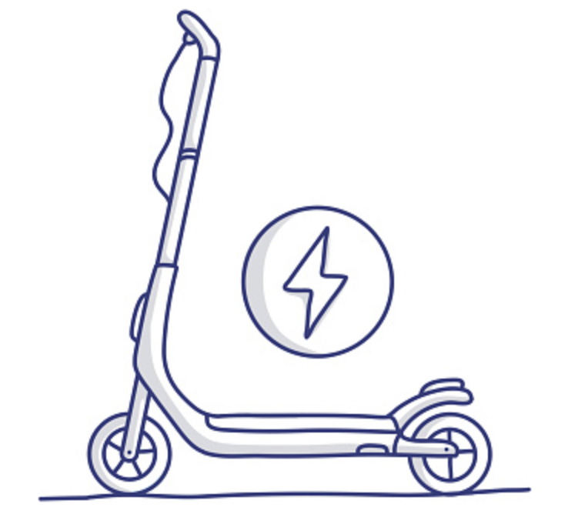
Goals and Objectives
Reduce the commute time
Reduce carbon dioxide emissions
Amount of energy used by the rider to be less
The costs to consumers
Maximize efficiency
To contribute to safety adding lights and sensors
Include an LCD screen
Incorporate a rechargeable battery that charges by regenerative brake

Slide 4
Specifications
Component | Parameter | Specification
Scooter | Unloaded weight | < 12 kg
Speed controller | Max loaded speed | > 15 mph
2 Batteries | Capacity | 4400 mAh
Headlight | Brightness | 100 lux
Motor | Power | 350 W

Slide 5
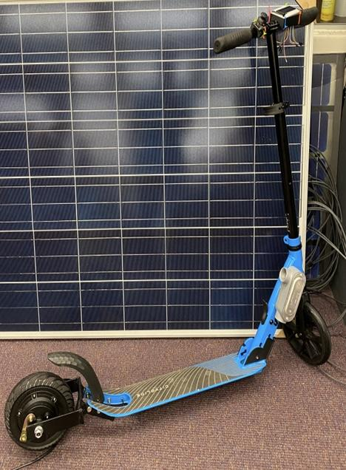
FINAL PICTURE
LCD
Joystick
Motor
Batterie
ESC

Slide 6
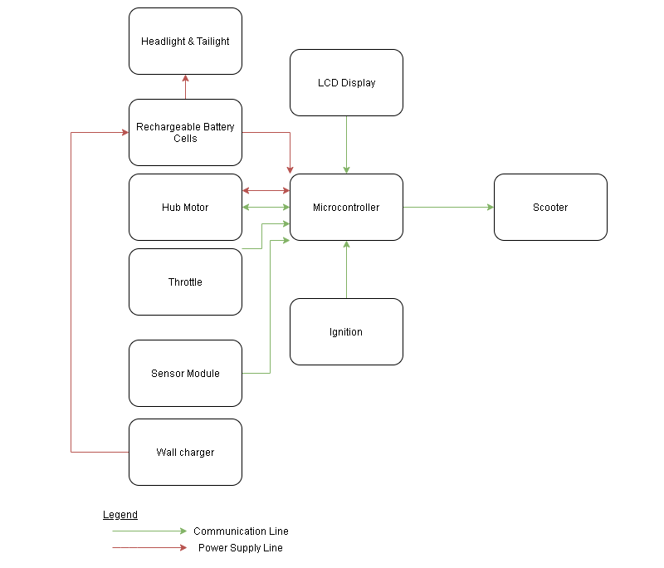
Overall Block Diagram

Slide 7
Hardware Design
Throttle
The purpose of the throttle in the electric scooter is to allow to control the speed while riding. It sends signals to the ESC and the motor on how much power to use.
Joystick
Mounted directly to the handlebar
Easier and more comfortable for the end-user
Pushed forward it will accelerate, middle position is idle and backward position it will work as regenerative brake
Joystick connected to the Atmega328p, and deliver power to motor via the ESC

Slide 8
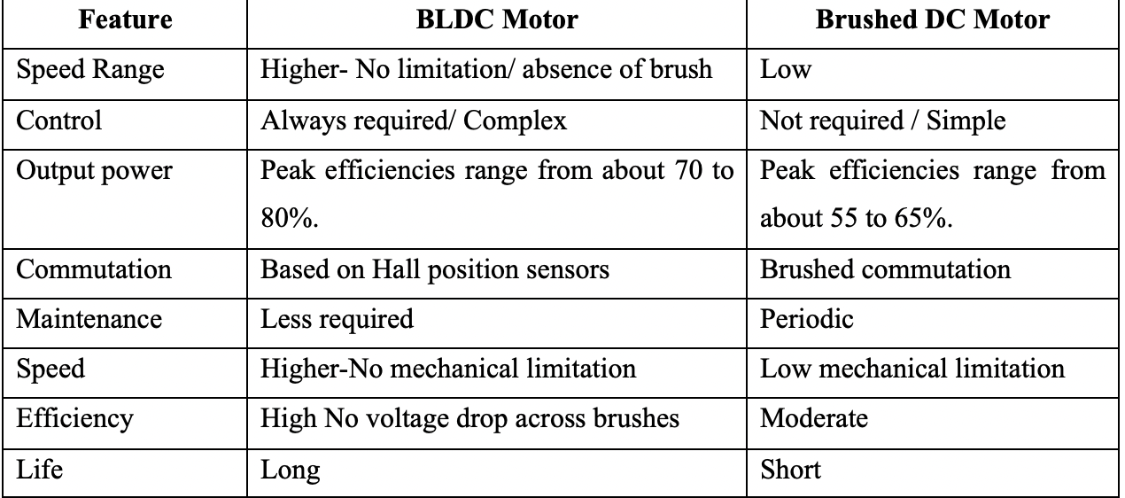
Motor
Brushed motor VS Brushless DC motor (DC VS BLDC)

Slide 9
RBSD Hub Motor
Direct drive hub motor with free spinning permanent magnet is driven by changing polarity of coils within the motor. These changes in polarity are a result of changes in the voltage levels of a triple phase input. Because the hub motor utilizes a magnet, we are able to use both the magnets resistance to spinning while surrounded by the conductant coils and the current that results from that spinning to implement regenerative brake into our design. However, the 3-phase input to the motor introduces complexity to our design in the form of addition hardware and software.
RBSD Hub Motor Parameters
[Power] 350 W
[Rated Power] 250 kW
[Rated Voltage] 24 Volts
[Wiring Harness] 3 phase line plus 5 hall

Slide 10
Electronic Speed Controller
Provides the vital function of controlling the power delivered from the battery to the motor. Alternating voltage level between the motor’s three phase input and with at a correct rate that allows for optimal motor operation. Additionally, our electronic speed controller will provide all sensor monitoring and provide all required command signals for our design.
Because of the three phase motor inputs, our speed controller utilizes MOSFETs to alternate which motor input will receive a high, low, or neutral voltage at a given time. The gate of each of the MOSFETs is connected indirectly to output pins of our MCU, allowing for the MCU to control the hub motor’s operation.
The ESC will also be responsible for monitoring several input channels from different sensors, such at the gyro-accelerometer, joystick, light sensors, and etc. Based on the sensor readings the ESC will provide automated control signals to the motor and light subsystems.

Slide 11
Voltage Regulation
The majority of our parts were selected to have compatible operating voltage ranges of approx 24V. However, there were several part and design integrations that required voltage upsteps or downsteps.
Notable examples include the downstep from the two serial battery packs, approx. 22.2V, to the microcontrollers 5V input and the downstep required from battery to the amplifier included in our light circuitry of 12V.

Slide 12
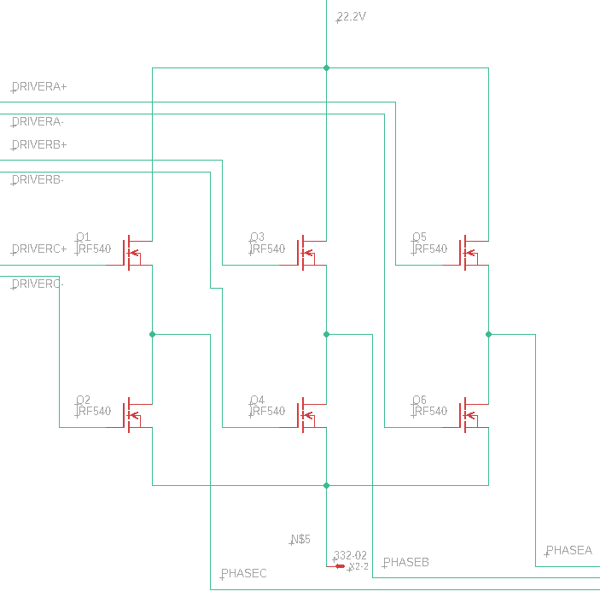
Mosfets
The most common configuration for sequentially applying current to a three phase BLDC motor is the use of MOSFETs and this the design strategy that we went with to implement our ESC’s controller over the motor output.
By using three pairs of power MOSFETs arranged in a bridge structure, each pair is able to control the switching of one phase of the motor. The MOSFETs are controlled by using the microcontroller-driver output applied to the MOSFET gates to open and close them.

Slide 13
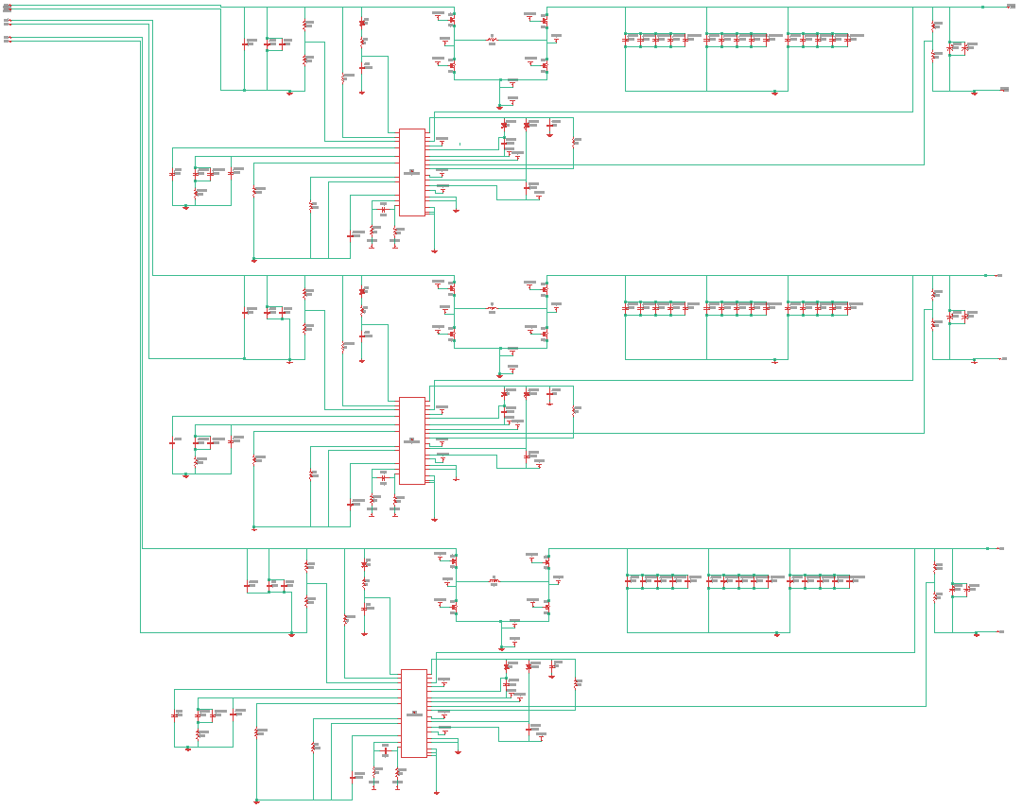
Drivers
The drivers that were included in our initial design, used to step up the outputs from our microcontroller output pins and apply the resulting 24V to the MOSFET gates and turn on the MOSFETs as needed, were ultimately unnecessary. Because the the nature of the 3-phase motor we used, where the voltage drop across the motor is minimum. We repurposed these drivers to be used with our light circuitry, replacing several voltage doublers.

Slide 14
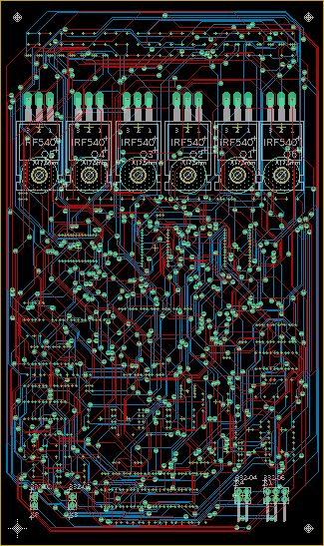
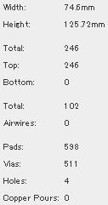
PCB
Our designed PCB will, in essence, act as the brain of the electric scooter, monitoring sensor data, Computing logic, and driving the motor. Additionally, the PCB will incorporate all required voltage regulations and switching required for our design.
A few of the PCBs functions are monitoring the light sensors in order to automatically control the headlight and taillight of the scooter,monitoring the accelerometer gyroscope sensor to monitor the tilt and acceleration and deceleration of the electric scooter to automatically limit certain parameters of the scooter's performance, monitor the state of the motor using a hall sensor, and controlling the 3-phase motor input to drive performance.

Slide 15
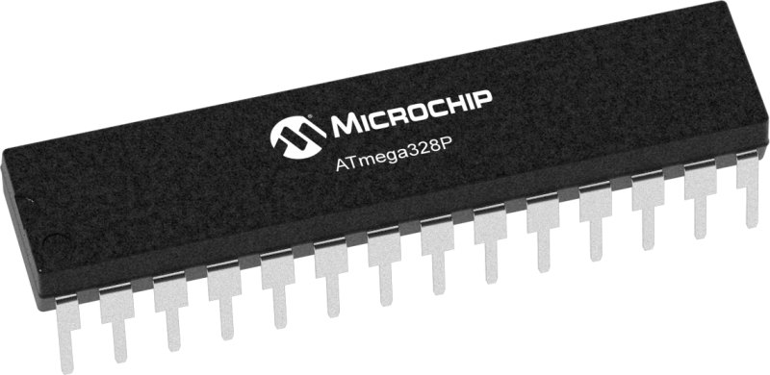
Software Functionality
The software portion of the EZ smart scooter will be implemented on the ATMega328P, which will be able to take in different types of inputs and outputs that will be utilized within our code. The code that will be implemented will have different functionality such as, sensor input from the Gyroscope Accelerometer to be able to read the incoming speed, the speed for the scooter will then be displayed on the LCD display for the user, and the motor will be receiving signals in rhythmic waves that will give info in relation to the speed. The code will be compiled on Arduino Integrated Development Environment (IDE).

Slide 16
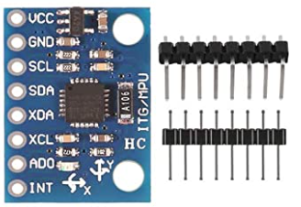
Sensor Input
The sensor allows the microcontroller to calculate the tilt of the scooter, which will be read from the Gyroscope Accelerometer. The input will be taken in by using a function called pinMode and we are going to use that function to call it “pinMode(gyro, INPUT)”. The gyroscope will be defined using the #define function which be connected into an analog input. To be able to calculate the tilt of the scooter we must use an interrupt function called ISR (TIMER0_COMPA_vect) which will be always running and needs to be continuous due to the fact that the tilt of the scooter needs to be constantly updated and read as a binary number with it being a digital HI or digital LO.

Slide 17
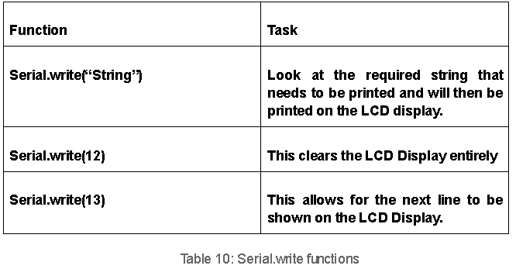
LCD Display
The LCD display will show the calculated speed values, location, time, and battery percentage from the sensor input calculation. There will be functions that will help format the LCD display to its best degree. The function that I am referring to are these:

Slide 18
Algorithm
This code will be represented in two different sections that will work towards two different tasks and obviously each task that is assigned will contain variables and constants that need being defined. Anything related to the inputs and outputs will be referred to the headers and library and these will always be at the top of the code like all other languages. Below is a representation of how a task will be compiled shown with descriptions.
LCD Display:
· Headers/Libraries
· START
· Clear display
· Print the Odometer which displays the speed
· Print the speed , location, time, and battery percentage
· END

Slide 19
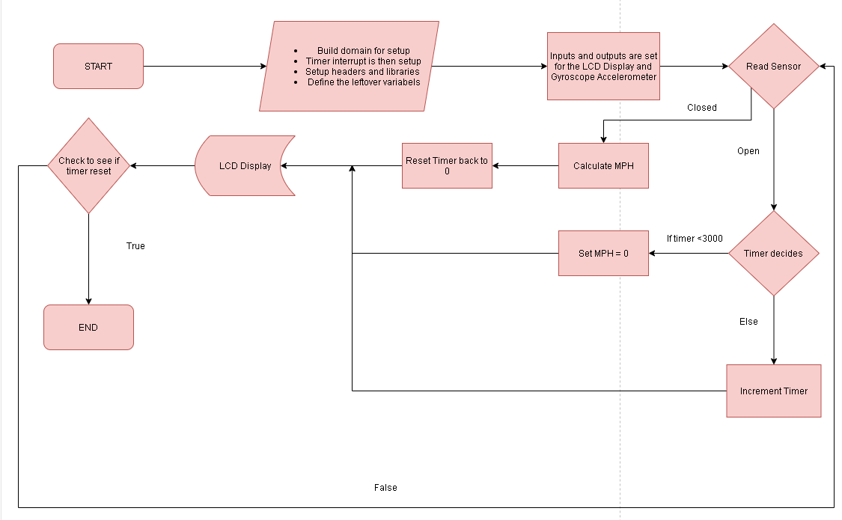
Coded Flowchart

Slide 20
Software Challenges
Learning new functions and libraries for Arduino IDE
How to apply the code for the LCD Display and Sensors
Possible grounding errors when making connections.
Common bootloader problems that I may come across at first

Slide 21
Budget
Description | Model | Cost | Status
Scooter |  | $69.99 | Acquired
LCD | HiLetgo HD44780 1602 LCD | $9.19 | Acquired
Microcontroller | ATMega328P | $23.80 | Acquired
Throttle | Joystick HiLetgo Game | $5.79 | Acquired
Hub Motor | RBSD Electric Scooter Hub Motor | $112.89 | Acquired
Headlight |  | $18.99 | Acquired
Light sensor(x5) |  | $6.89 | Acquired
Gyro-accel(x5) | GY-521 MPU-6050 | $10.99 | Acquired
Other Components | Amplifier, Mosfets,PCB, Capacitors... | $250.00
Gross Budget : $800.00

Slide 22
QUESTIONS ?

